Slide 1

Hipikat:
A Developer’s Recommender
Davor Cubranic, Gail Murphy,
and Kelly Booth
University of British Columbia

Slide 2
Introduction
Hipikat
  suggests artifacts that might be useful to a developer for a task underway
Prototype instantiated for Eclipse
  client as an Eclipse plug-in
  daily updates with Eclipse development

Slide 3
The problem
Best knowledge about a software system:
  resides in developers’ heads
  spread via informal and lightweight processes
What happens in virtual teams?
  Time and distance separation
  Communication more difficult
Mentoring and support weak or non-existent

Slide 4




The virtual alternative
Everybody collaborates via the Internet
Turn electronic communication into an asset:
  Source code versioning
  Archives of electronic
  communication
  Test information
  Design decisions
Give developers access to this
implicit and latent group memory

Slide 5


Information is there
Information overload:
hundreds of emails and
newsgroup postings
every week
Searching it is tedious and time-consuming

Slide 6
The solution
Create a group memory of all artifacts in the project
Recommend artifacts that might be of value when performing a task
  similar changes
  related email discussions
  relevant project Web pages
Minimal changes to existing work practices

Slide 7



Information schema
Artifacts from various information sources
Infer “linkages” within and across sources
Issue-tracking system at the centre
Text
similarity
Web site
Text
similarity
Newsgroups
CVS
Text
similarity
Implements
change task
Bugzilla

Slide 8
Eclipse.org
Intense development
  Avg. 170 revisions checked in daily (in Oct.)
  Avg. 47 new bug reports entered into Bugzilla
  Avg. 149 comments/day on existing reports
Active developer lists
  Over 100 articles/day on newsgroups
Daily Hipikat updates

Slide 9
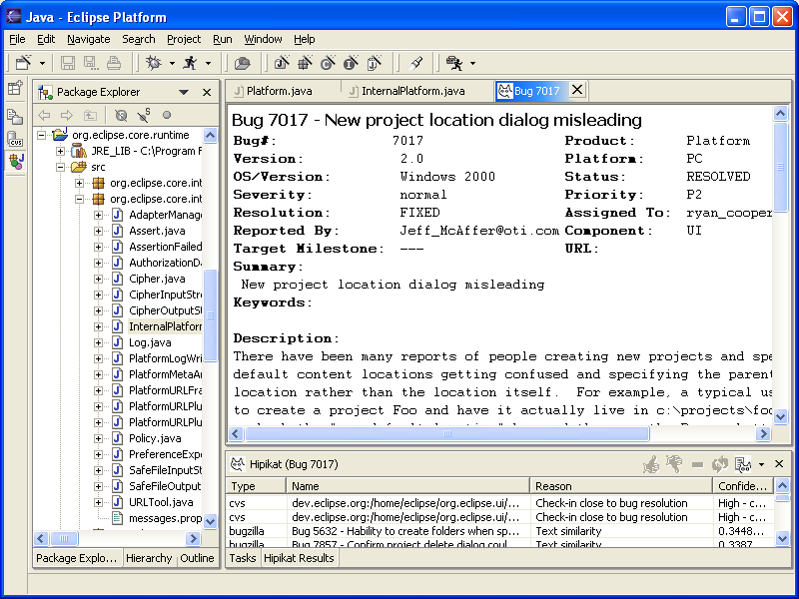
Hipikat in Eclipse

Slide 10
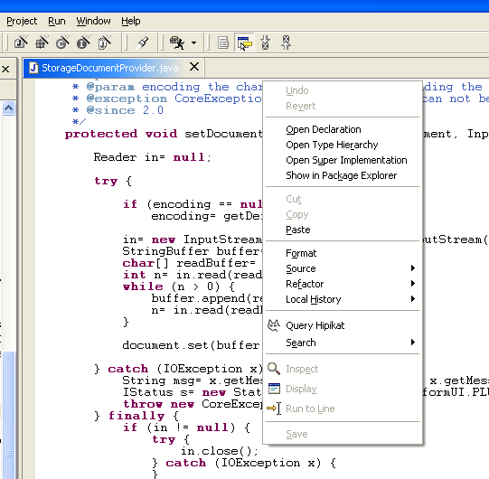
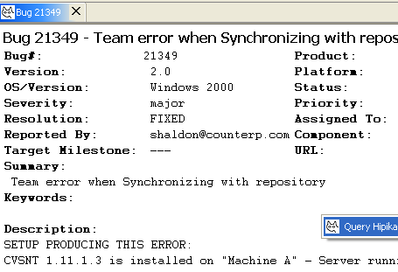
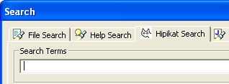
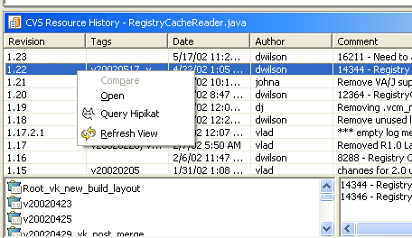
Accessing Hipikat
Any artifact in the Eclipse Workspace can serve as a query point
Hipikat keyword search from the Eclipse search dialog

Slide 11
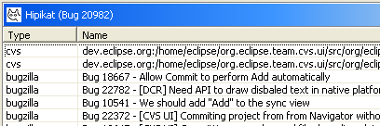

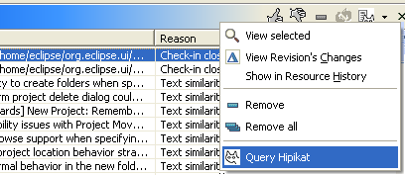
Viewing results
Matching artifacts listed in the Hipikat view
Includes reason for recommendation and confidence
Can make further queries on the recommendations

Slide 12
Example 1: Using the API
Change task:
Adding files to version control
Immediate goal:
Traverse the directory tree looking for
unmanaged resources
Relevant Eclipse API:
IResource interface with its subinterfaces
IFolder and IFile represent resources in the
file system

Slide 13
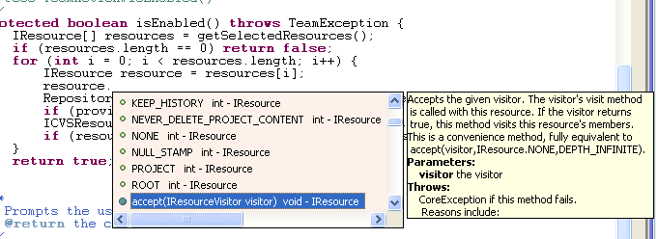
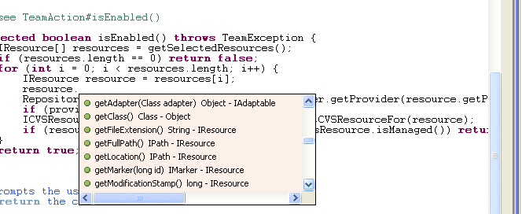
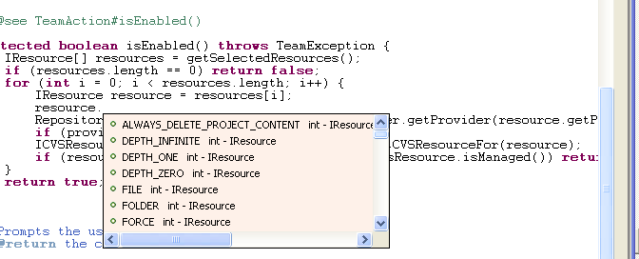
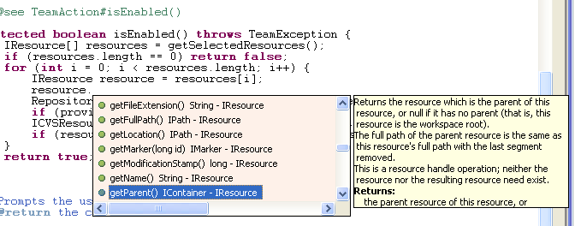
IResource code-assist
Problem: Not immediately obvious how to use the API to traverse the directory tree

Slide 14
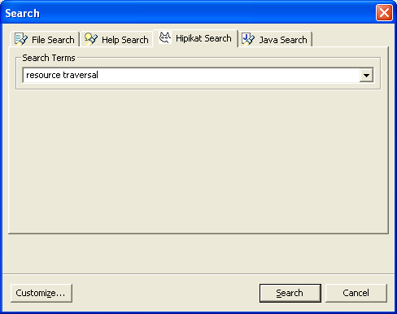
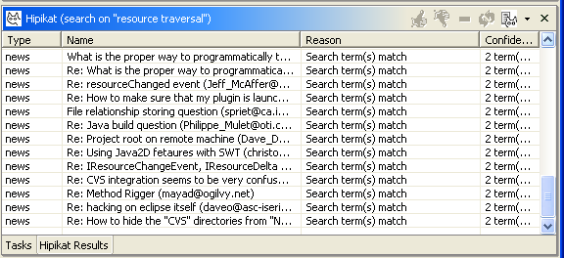
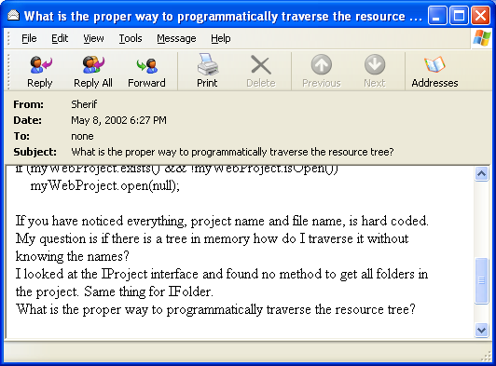
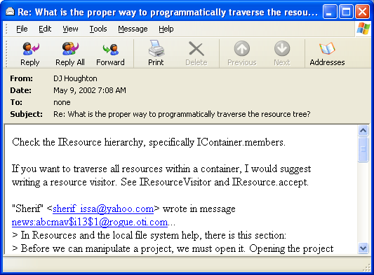
Hipikat search

Slide 15
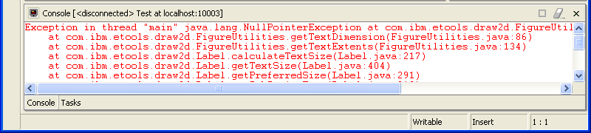
Example 2:
Debugging exceptions
A NullPointerException persistently occurs from Eclipse UI call, although it is not clear why from the documentation
Eclipse bug?

Slide 16
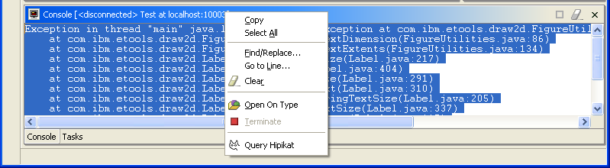
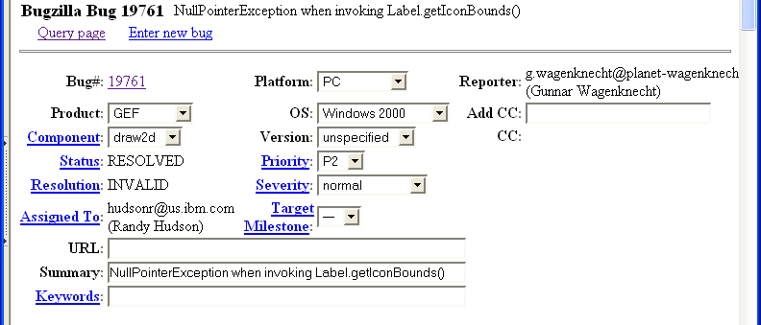
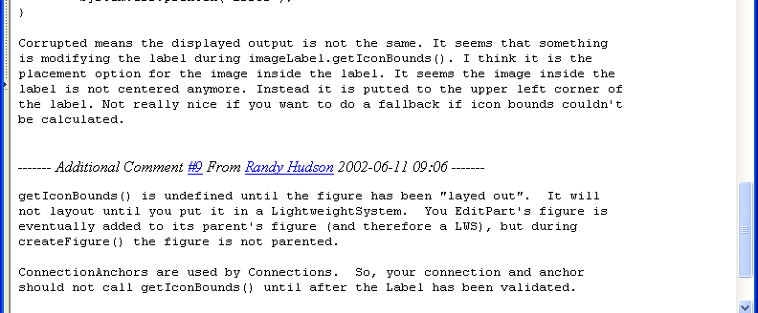
Query on console output

Slide 17
Example 3:Making a change
A project newcomer is about to start working on an enhancement request
Where to start?
Look at similar work that was done in the
past, and see how it was implemented
  starting point
  code to reuse
  project idioms and implementation patterns

Slide 18
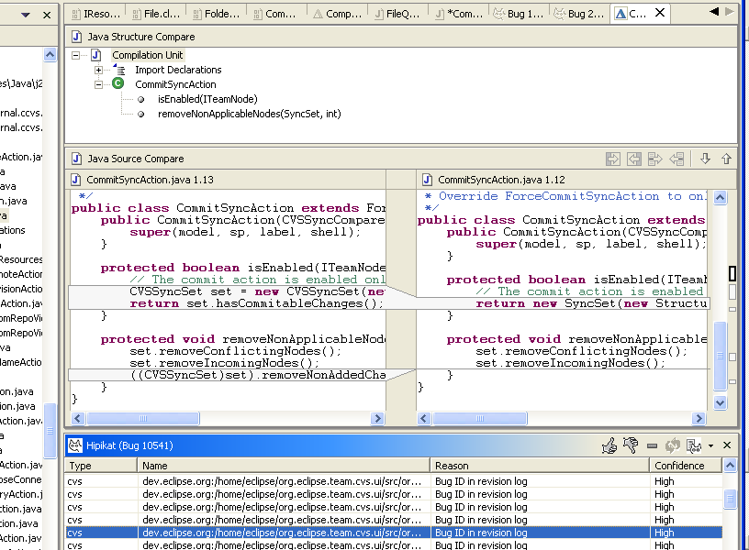
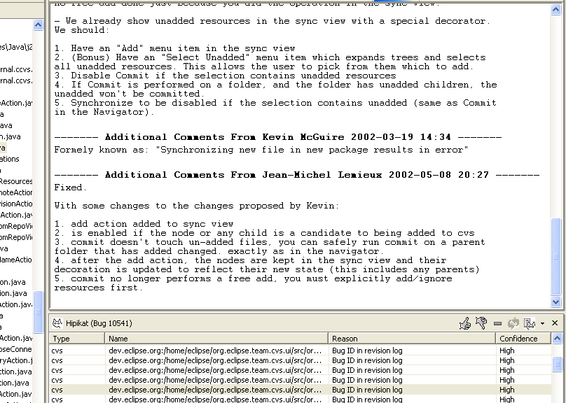
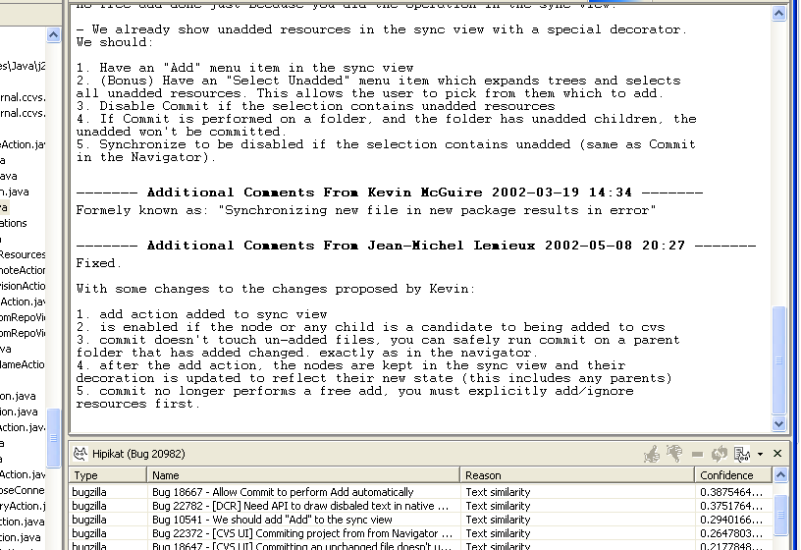
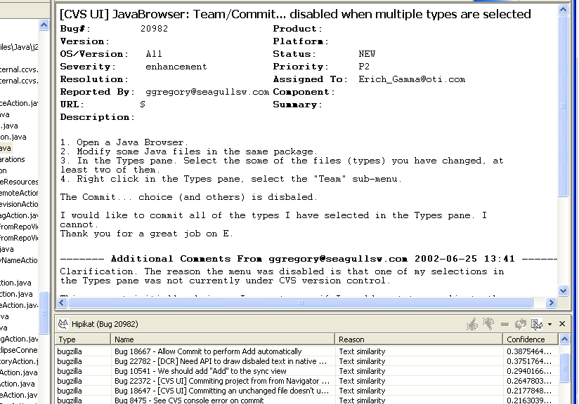

Slide 19
Hipikat
A developer’s recommender
Prototype instantiated for the Eclipse IDE
Download from
www.cs.ubc.ca/labs/spl/projects/hipikat/
Work supported by CSER and OTI

Slide 20
Project Web site: www.cs.ubc.ca/labs/spl/projects/hipikat/

